Slide 1

Presentation on project topic Rewiew 3
By
Following BE Students of Dep. Artificial Intelligence and data science
Coordinated by Prof. Suraj Bhoite
Group member names :
Vedant Sase (BE,Roll no: 24155)
Prasad Patil (BE,Roll no: 24152)
Sunny Gangurde (BE,Roll no: 24159)
Somesh Chaudhari (BE , Roll no: 24133)
Under the Guidance of Prof. Mrs. Asmita Mali

Slide 2
Problem Statement :
Nowadays because of unpredictable weather and market conditions it is difficult for farmers to choose, manage their yields, to solve this problem we are presenting a software which will consider and solve above problems.

Slide 3
Abstract :
This project uses data on soil and weather conditions to provide personalized advice to farmers, helping them grow crops more efficiently and sustainably. By analyzing factors like soil nutrients, temperature, and rainfall, we can identify the best ways to manage crops, reduce waste, and promote healthy growth.

Slide 4
INTRODUCTION :
SmartAgri Advisor is a cuttingedge tool that empowers farmers with precise, datadriven crop recommendations. By leveraging AI, machine learning, and big data, it provides personalized advice on crop selection, cultivation practices, and resource management. This technology helps optimize resource use, enhance productivity, and promote sustainability, making it an essential tool for modern, sustainable agriculture.

Slide 5
RESEARCH GAP IDENTIFICATION :
Limited integration of soil and weather data:
Most existing research focuses on either soil or weather data, but not both.
Limited farmer adoption and user experience:
Many crop recommendation systems are not userfriendly or fail to account for farmer preferences.
Insufficient use of machine learning algorithms:
While machine learning is widely used in agriculture, its application in crop recommendation systems is still limited.

Slide 6

AIM AND MOTIVATION :
Our aim is to increase crop yields, reduce environmental impact, and support farmers in making datadriven decisions. This approach can help meet the world's growing food demands while protecting the planet.

Slide 7
SCOPE AND MOTIVATION :
Scope:
Explore how soil and weather data can improve crop management.
Bridging the gap where it Connect farmers, researchers, and technology to promote sustainable agriculture.
Objectives:
Develop a system that provides personalized crop recommendations to farmers.
Create a userfriendly platform for farmers to make datadriven decisions.
Advance our understanding of how soil, weather, and crops interact.
Share findings to benefit farmers and the environment global.

Slide 8
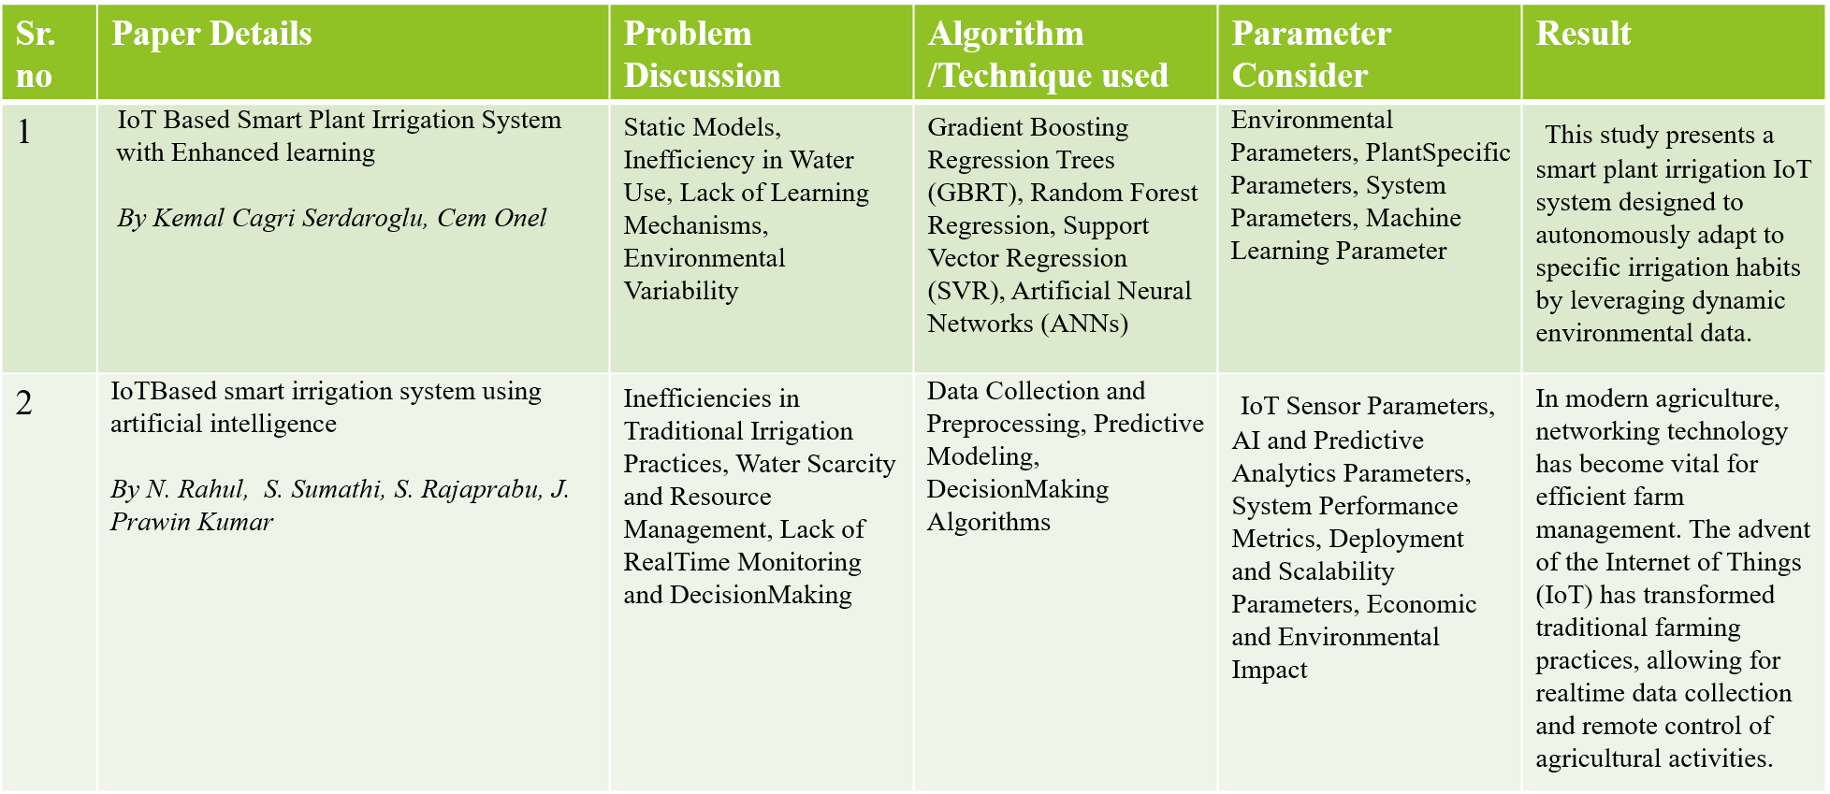
Literature review :

Slide 9
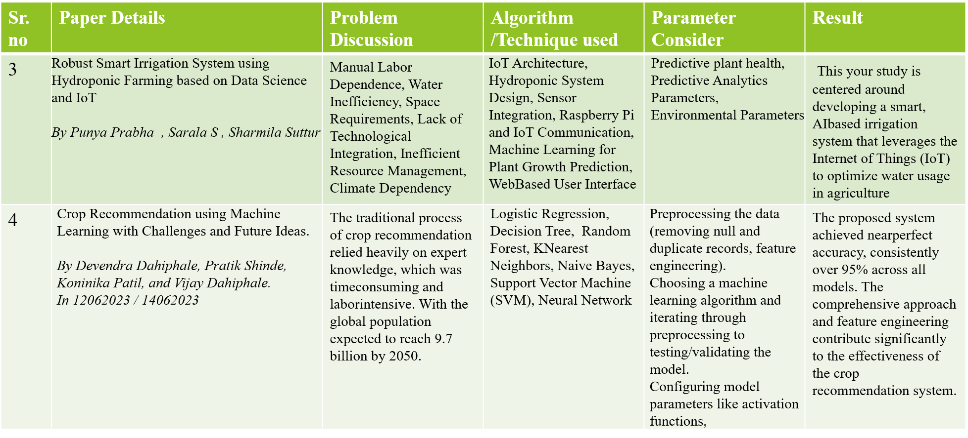
Literature Review :

Slide 10
ROADMAP BUILDING :
Workflow Overview:
Input: Soil conditions, crop data, weather data, market scenarios. Process: Analytical and machine learning models to analyze data. Output: Recommendations for crop choices and market scenarios.

Slide 11

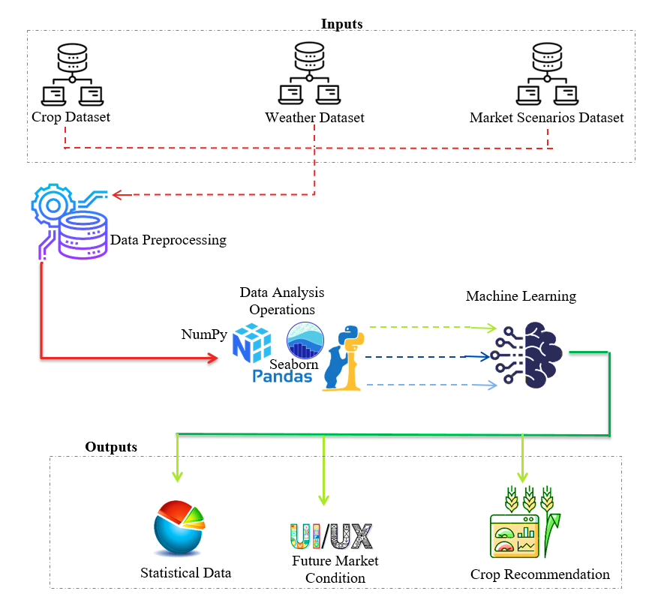
System Architecture Planning :
Architecture Overview
This workflow includes soil conditions, Crop data set from Agriculture Universities, weather data of that particular region, Market Scenarios are taken as input for different analytical and Machine learning models which provides a clean and clear data representation in form of statistical data. It mainly focuses on recommending crop and future market scenarios about yield cost and available stock.

Slide 12
System Architecture Planning :
Components:
Data collection
Data processing
Data analysis
Machine Learning
Recommendation modules.
System Requirements:
Software: Windows or Linux
Programming Languages : Python, Java Script / Node.js
Development Frameworks : Flask, TensorFlow.
Database : MySQL, MS-SQL, MongoDB, Apache Kafka.
Hardware: i5 Processor, 512 GB SSD, 8GB RAM.

Slide 13
Requirement of Design / algorithms / techniques used
Requirements:
Climate and weather data
Soil type and nutrient data
Crop characteristics data
Farmer preferences and goals
Geographic location
Historical crop yield data
Real-time weather forecasting
Design:
Web/Mobile Application
API-based architecture
Cloud-based deployment
Database management system (DBMS)

Slide 14
Data analytics and visualizationAlgorithms and Techniques
Algorithms and Techniques:
Data cleaning
Data normalization
Feature scaling
Principal Component Analysis (PCA)
Feature selection

Slide 15
Modules split-up
Module 1: Data Collection- Collect soil, weather, crop, and farmer data Module.
Module 2: Data Preprocessing- Clean, transform, and extract features from data Module.
Module 3: Crop Yield Prediction- Develop machine learning models for yield prediction Module .
Module 4: Crop Recommendation- Develop rule-based recommendation engine Module.
Module 5: User Interface- Design and develop web/mobile application Module
Module 6: System Integration & Deployment- Integrate modules, deploy on cloud Module.
Module 7: Maintenance & Updates- Monitor, fix bugs, update models.

Slide 16
Risk Identification :
1. Risk Identification :
In the face of growing challenges in modern agriculture, farmers need precise and sustainable methods to enhance crop yield while managing resources effectively.
2.Risk Analysis:
Data Accuracy: High impact, as incorrect data can lead to poor decisionmaking. It depends on the sources and methods of data collection.
Sensor Malfunction: Sensor failures could disrupt irrigation automation.
Market Volatility: Sudden market changes might reduce recommendation effectiveness.
Adoption Resistance: Farmers may be hesitant to adopt new technology.

Slide 17
Risk Identification :
Risk Mitigation: Ensure Data Quality: Implement validation techniques to ensure accurate data. Redundant Systems: Use backup sensors and manual overrides for irrigation. RealTime Updates: Regularly update market data to keep recommendations relevant. User Training: Provide training to encourage technology adoption by farmers.
Monitoring and Management: Regular Audits and Diagnostics: Continuously monitor data and sensors. Market Reviews: Periodically review and update market data. Feedback Loops: Collect farmer feedback to improve the system. Contingency Planning: Prepare alternative strategies for identified risks.

Slide 18
Proposed System
Comprehensive Software Solution: SMART-AGRI ADVISOR provides farmers with data-driven crop recommendations tailored to their specific needs.
Advanced Analytics: Leverages real-time data, including weather forecasts and market trends, to support informed decision-making.
Crop Selection & Yield Management: Offers insights to help farmers choose the best crops and manage yields effectively.
Resource Optimization: Guides efficient resource allocation, improving productivity while reducing waste.
Sustainability Focus: Promotes sustainable agricultural practices by optimizing inputs and reducing environmental impact.
Risk Mitigation: Addresses the challenges of unpredictable weather and market fluctuations, helping farmers manage risks.
Improved Farm Management: Enhances overall farm operations with actionable strategies, leading to better outcomes.

Slide 19
Software Tools/Technologies to be used
Frontend (User Interface):
HTML/CSS/JavaScript: For basic website development.
React.js or Angular.js: For interactive web apps.
React Native or Flutter: For mobile apps.
Backend (Server):
Flask or Django (Python): For handling user requests.
MySQL or PostgreSQL: For structured data
Node.js: For real-time data handling.
Data Collection:
OpenWeatherMap API: For weather data.
Agriculture APIs: For market trends and crop prices.

Slide 20
Project Plan 2.0
Helps farmers by providing crop recommendations based on weather, market prices, and soil data.
Aims to improve farm productivity and promote sustainable farming.
Provide accurate crop suggestions to farmers.
Use real-time weather, soil, and market data for better crop selection.
Encourage sustainable farming practices by improving yields
Weather-based Tips: Crop suggestions based on current weather conditions.
Market Analysis: Crop recommendations using market trends to increase profits

Slide 21
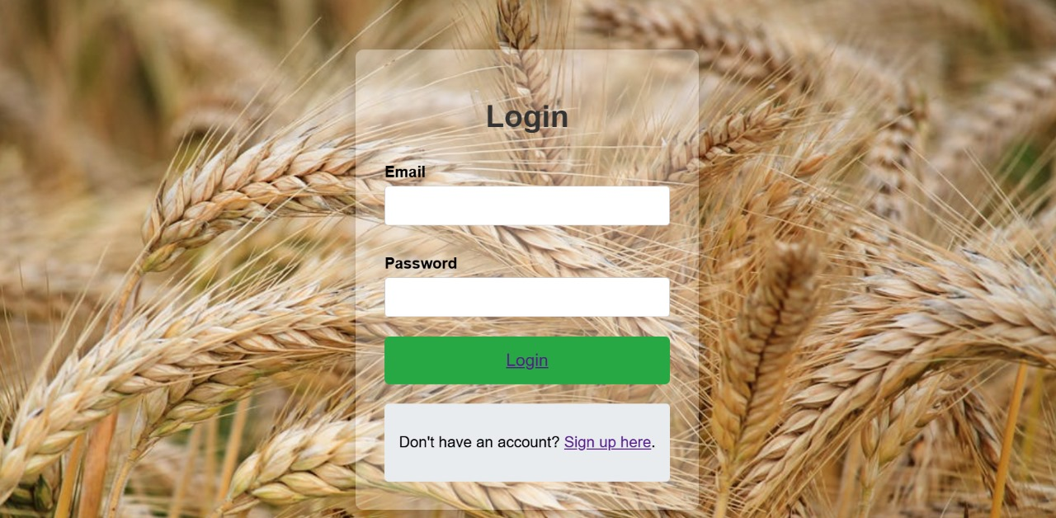
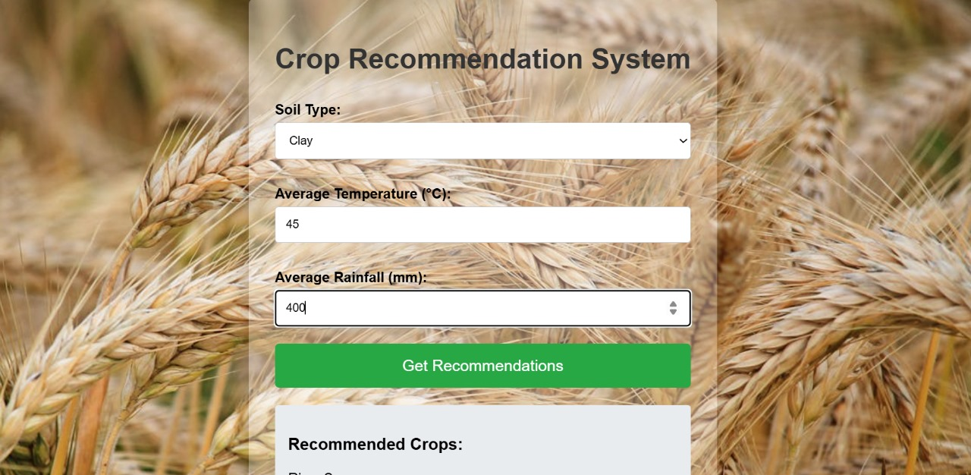
Result:

Slide 22
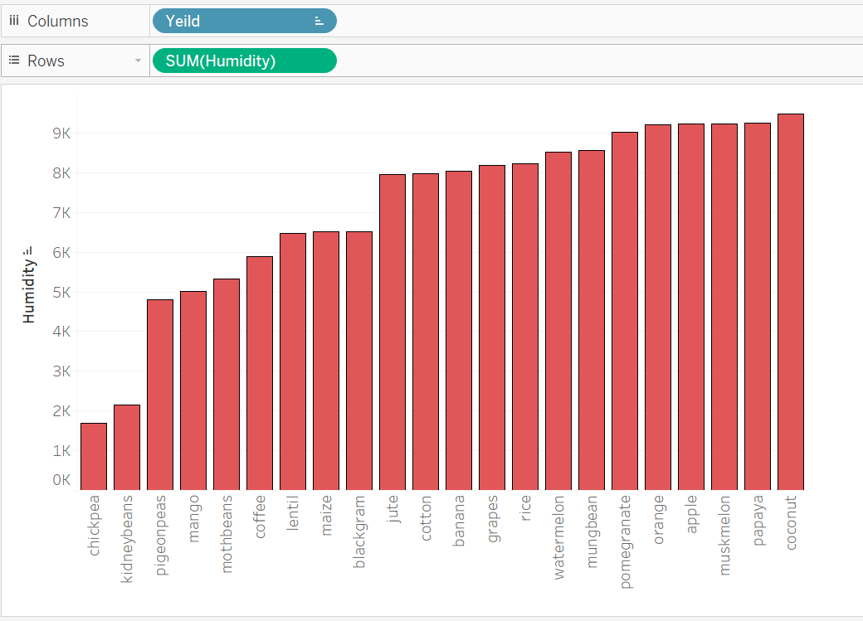

Slide 23
Conclusion : - This is project review stage 2 and we have studied the requiredment analysis, requiredment gathering(hardware, software), source management, risk identification, risk analysis and finding solution on it.

Slide 24
Thank You!

